Slide 1

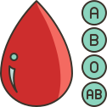



TEAM 5
BLOOD GROUP IDENTIFICATION

Slide 2



INTRODUCTION
The Blood Group Identification System is an innovative, Python-based computer vision application utilizing OpenCV to automatically determine an individual's blood group from uploaded images.
By applying advanced image processing techniques and predefined conditions, this system accurately detects and classifies ABO and Rh blood types. With its intuitive interface and rapid analysis, this tool facilitates efficient and accurate blood group identification, supporting medical professionals, researchers, and individuals in making informed decisions regarding blood transfusions, medical treatments, and personalized care.

Slide 3

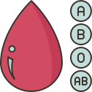

PROJECT OVERVIEW
CUSTOMER FEATURES
CREATE A NEW USER ACCOUNT TO ACCESS THE APPLICATION
LOGIN WITH YOUR USERNAME AND PASSWORD
UPLOAD IMAGE OF BLOOD SAMPLE FOR ANALYSIS
OUTPUT
ORIGINAL IMAGE: DISPLAYS THE UPLOADED IMAGE.
MORPHOLOGICAL IMAGE: SHOWS PROCESSED IMAGE WITH HIGHLIGHTED FEATURES.
DETECTED BLOOD GROUP: DISPLAYS RESULTS

Slide 4

MILESTONES
IMAGE UPLOAD
WEBSITE SETUP
2
1
The system allows to vist the website and to see the about the web page and the registration page and the login page
In the profile page we can upload the image of the blood sample
where through the OpenCV we can analyze the picture and we can get the output blood type through few conditions
BLOOD TYPE AND CONTOUR LENGTH
OUTPUT VISUALIZATION:
3
4
Displays the uploaded image, processes it into a morphological image highlighting key features, and detects the blood group
Upon uploading the image, the website displays the contour length of the blood cell which helps us in determining the blood type

Slide 5

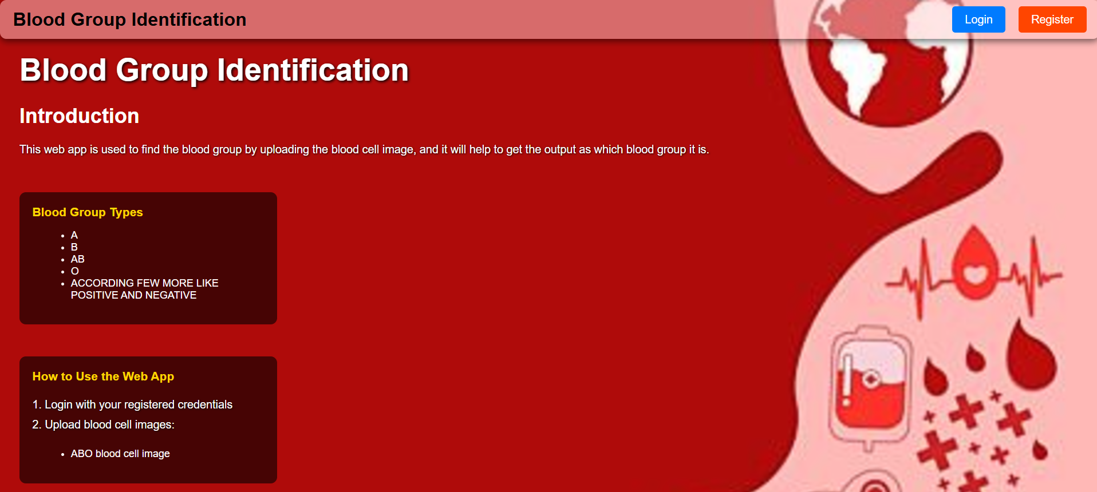
HOME PAGE
SCREENSHOT

Slide 6
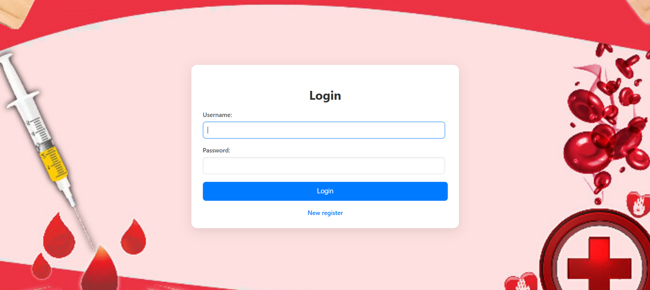

LOGIN PAGE SCREENSHOT

Slide 7
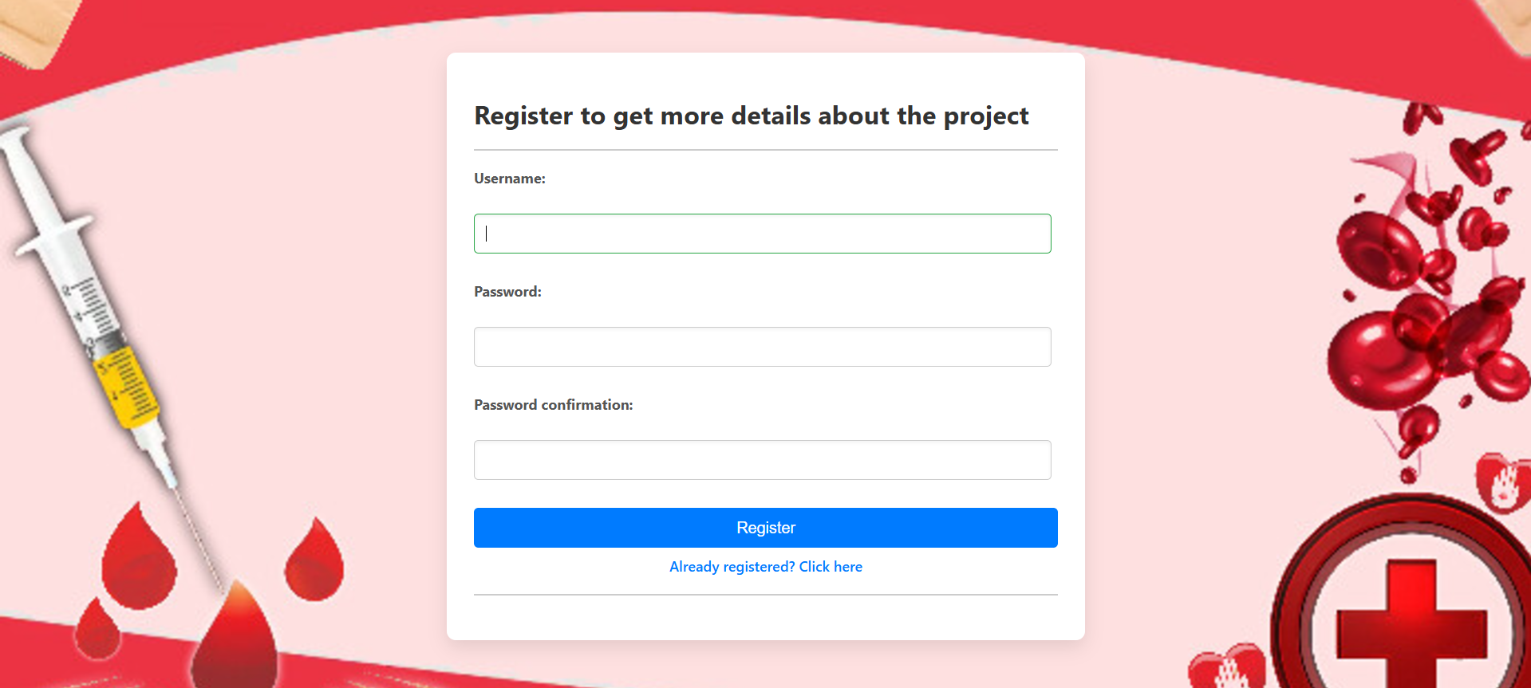
REGISTRATION
SCREENSHOT

Slide 8
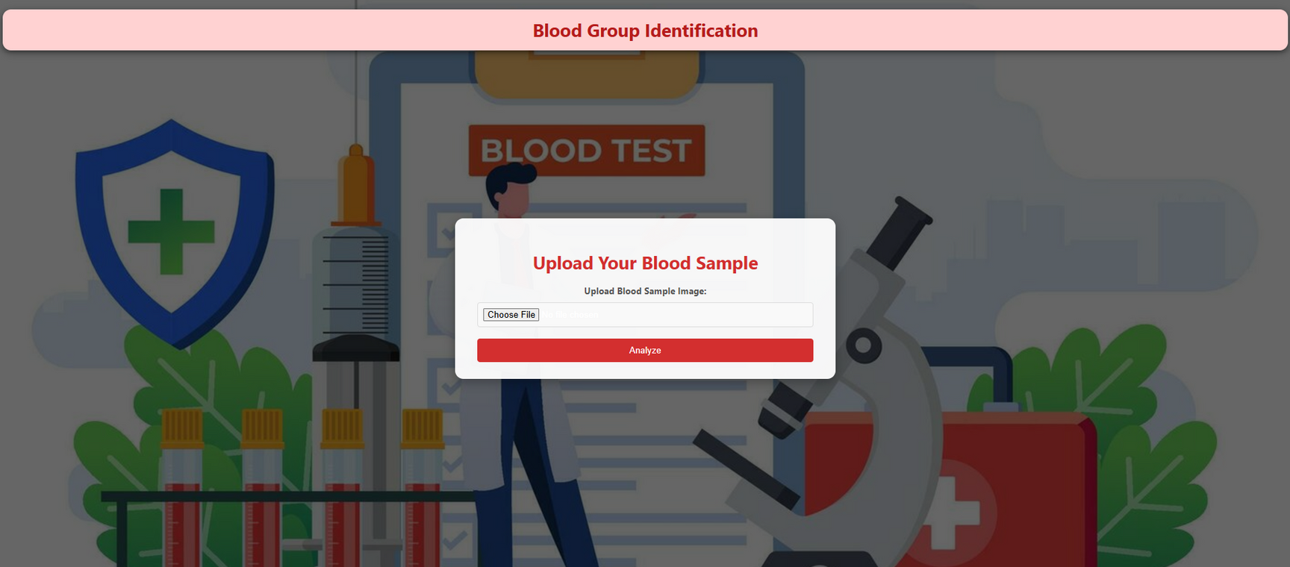
PROFILE PAGE SCREENSHOTS

Slide 9
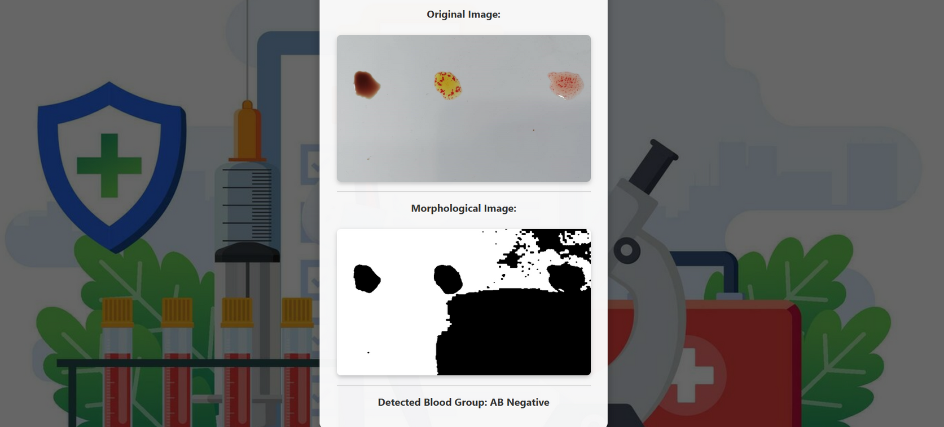
INPUT AND OUTPUT SCREENSHOTS

Slide 10
LIVE DEMO

Slide 11




CONCLUSION
The Blood Group Identification System successfully integrates computer vision technology using OpenCV to analyze blood sample images and determine the corresponding blood type. Key features include:
- User-friendly website with About, Registration, and Login pages
- Profile page for uploading blood sample images
- Automated image analysis using OpenCV
- Accurate blood type determination through predefined conditions
- Displays the uploaded image, processes it into a morphological image highlighting key features, and detects the blood group
Milestones Achieved:
Development of user interface and registration/login functionality
Integration of OpenCV for image analysis and blood type determination
Function which calculates and displays the contour length of the blood cells from the image uploaded by the user.
Displays the uploaded image, processes it into a morphological image highlighting key features, and detects the blood group

Slide 12


TEAM MEMBERS
Ande Gayathri
Utkarsh Khotele
Vinit Dey

Slide 13





Thank You

